Slide 1
Machine Learning and Cybersecurity
Dane Morgan

Slide 2
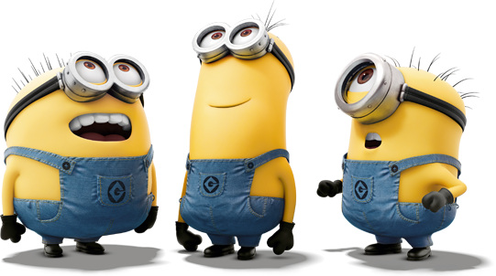
Outline
Machine Learning:
The What
The Why
The How

Slide 3
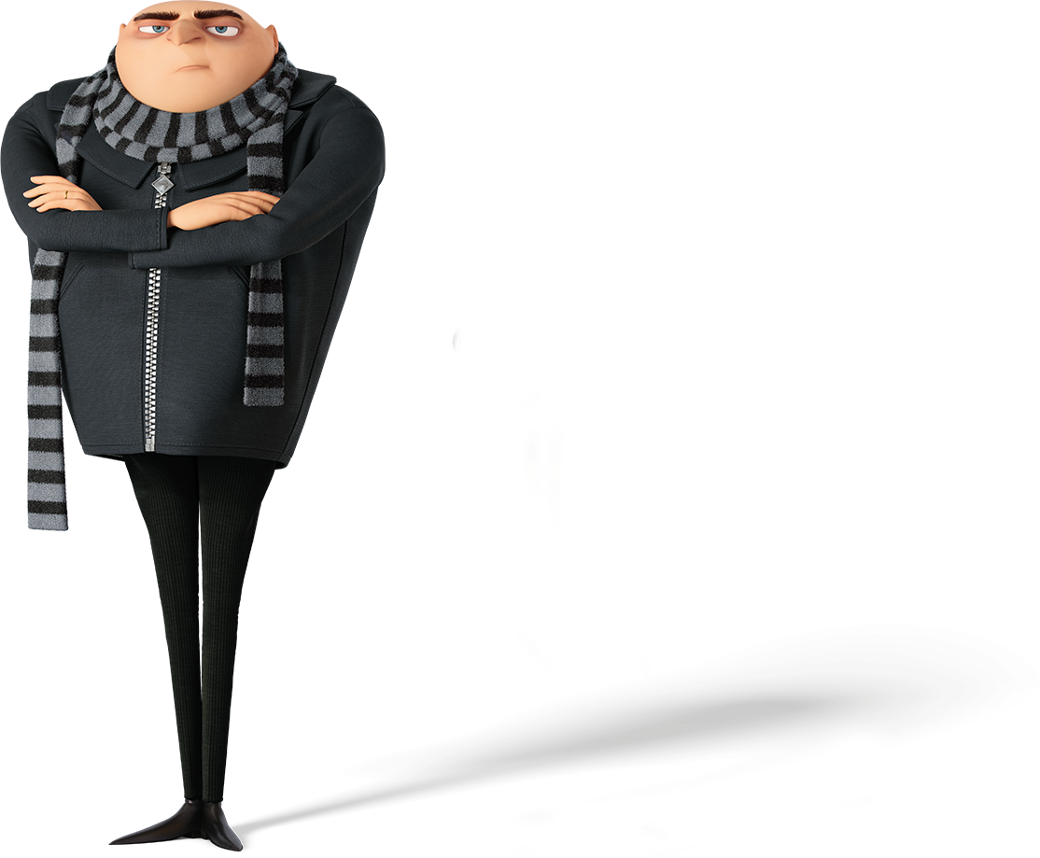
The What?
What are humans good at?
Being Creative
Making Decisions
Connecting the Dots
What are computers good at?
Following Instructions
Doing Math
Working until they break
What are humans bad at?
Following Instructions
Doing Math
Working until they break
What are computers bad at?
Being Creative
Making Decisions
Connecting the Dots

Slide 4
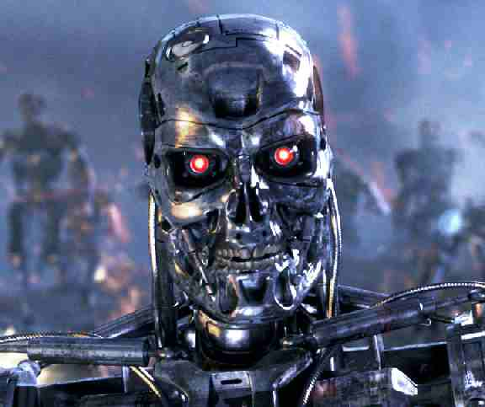
The What?
Why Despicable Me?
Combine speed of a computer with the pattern matching ability of person

Slide 5
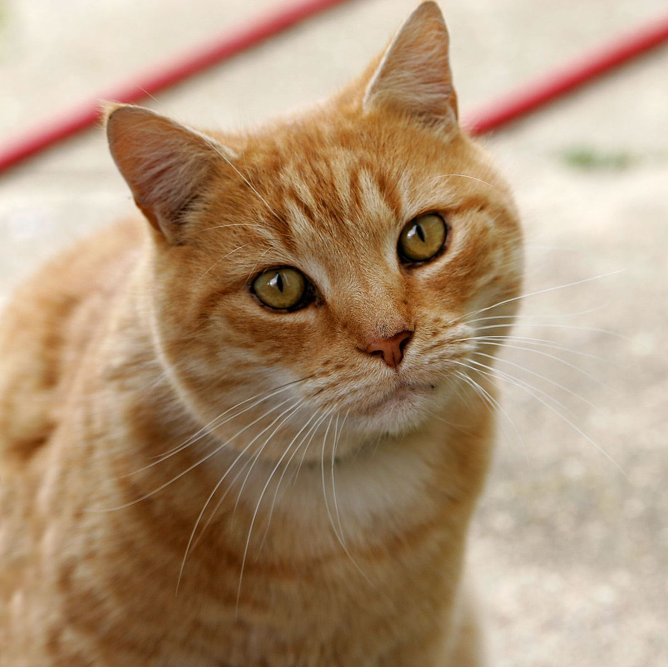
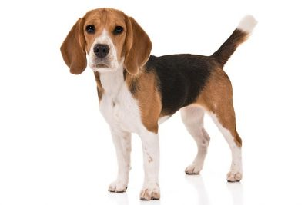
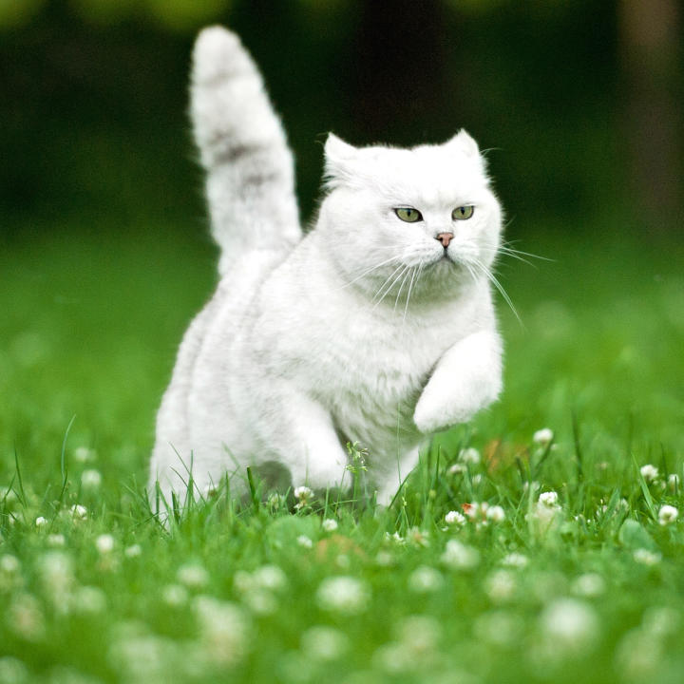
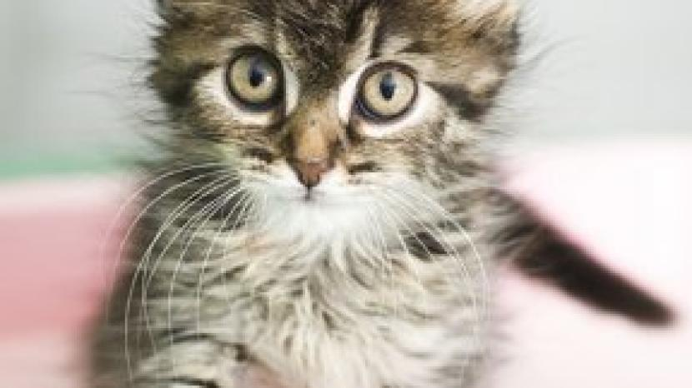
The What?
One of These Does Not Belong

Slide 6

The Why?
Neural Network

Slide 7
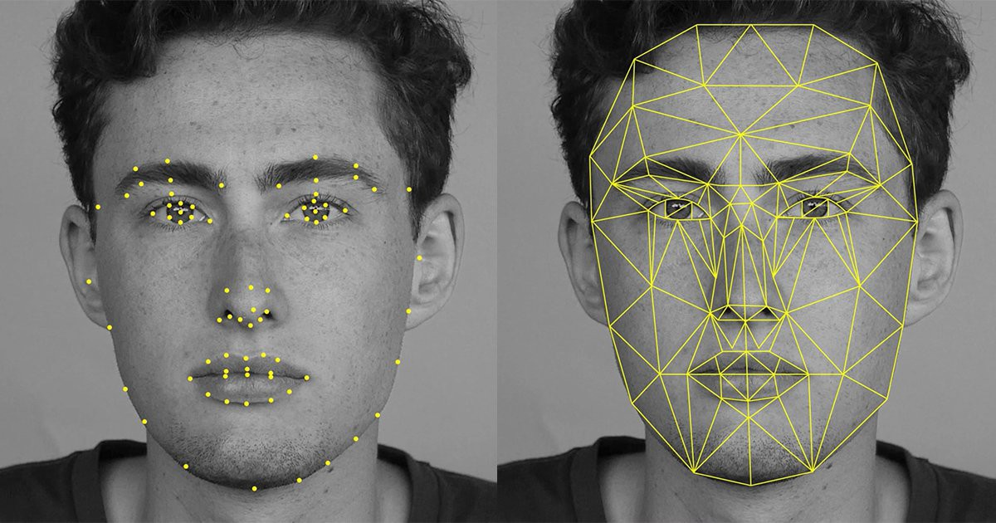




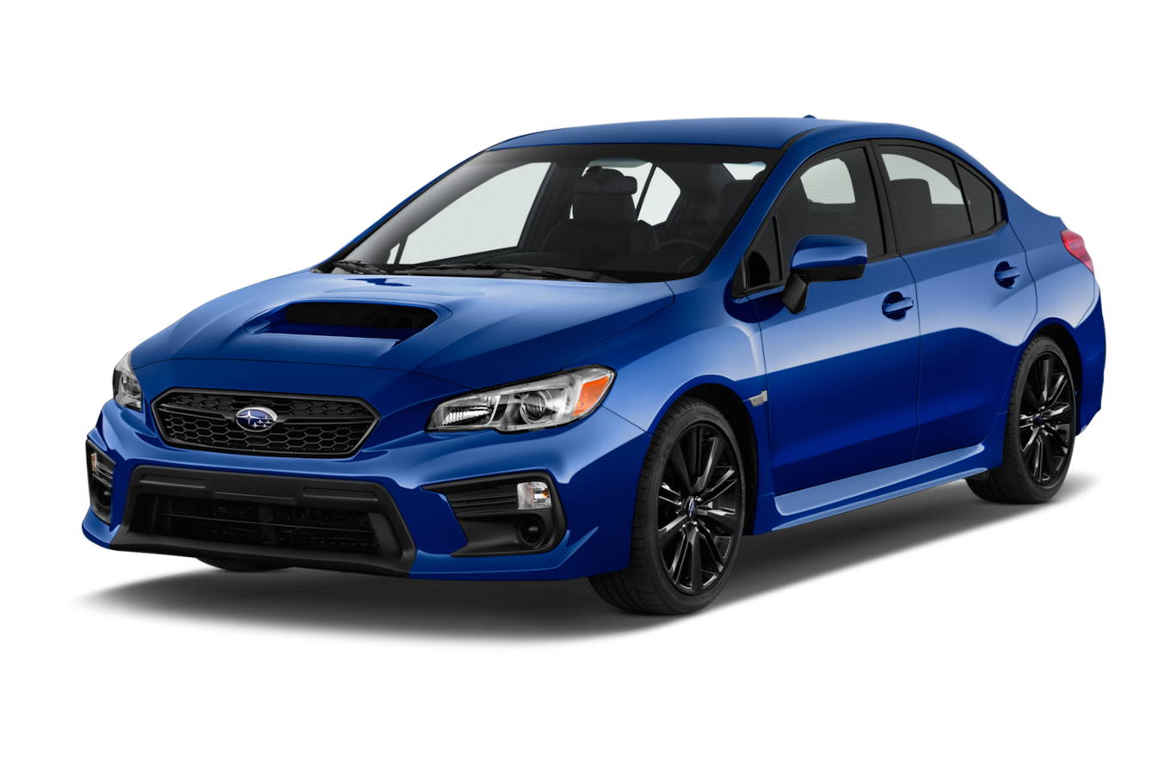
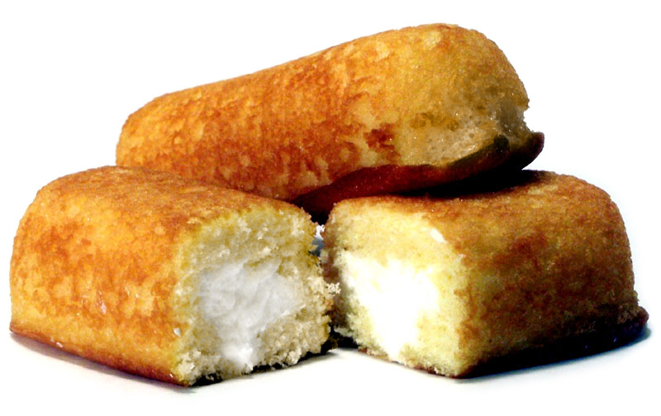

The Why?

Slide 8
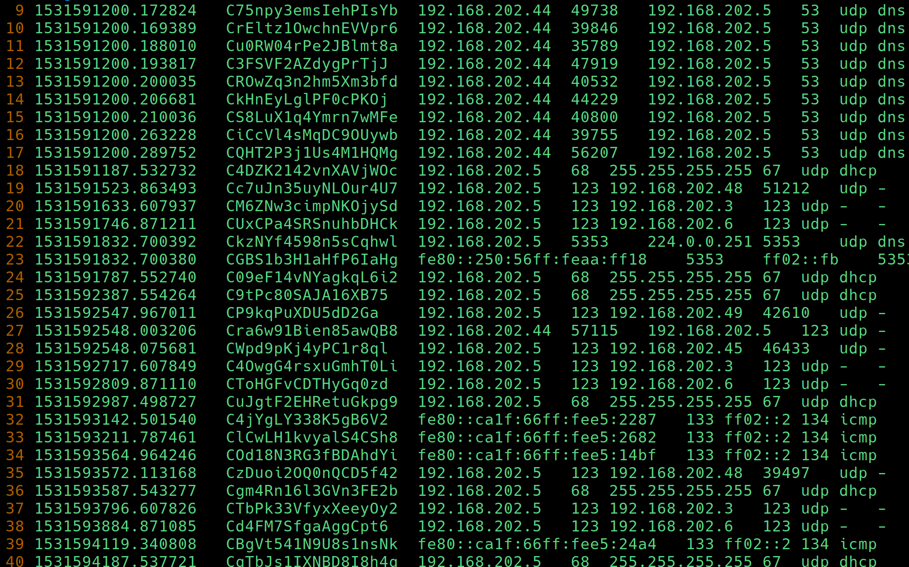
What about Cybersecurity?
BYU’s Network
24 / 7 data generation
20,000-30,000 lines of data a second!
Recognize patterns for
Attacks
Hackers
Malware

Slide 9

The How
Machine learning has become very approachable for beginners
Python3, C/C++, Julia, and Scratch

Slide 10

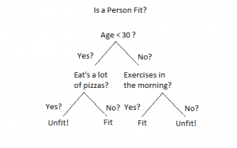
The How: Decision Tree

Slide 11

Vocab
Data
facts about something collected together
Dataframe
a collection of a data, separated into rows and columns
Feature
something about data
Target
the desired result
Training Data
data used to teach our computer
Test Data
data to test our computer’s ability to recognize patterns

Slide 12

The How: Iris Flowers

Slide 13
Here’s Our Decision Tree!

Slide 14
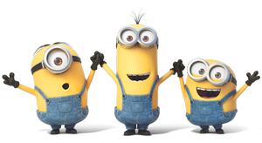
Questions?

Slide 15
Sources
https://www.xoriant.com/blog/product-engineering/decision-trees-machine-learning-algorithm.html
https://medium.com/@haydar_ai/learning-data-science-day-21-decision-tree-on-iris-dataset-267f3219a7fa
https://www.youtube.com/watch?v=LDRbO9a6XPU

